Slide 1
VFit XR E-COMMERCE & RETAIL-TRANSFORMATION
METAMINDS

Slide 2

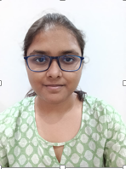



OUR TEAM
Yeswanth Yadav
Student
yeswanthyadav44@gmail.com
Aditi Prasad
Student
aditijprasad9@gmail.com
Jiya Visariya
Student jiyavisariya@gmail.com
Aniket Chinchankar Developer
a1n0i4ketc@gmail.com

Slide 3


PROBLEM STATEMENT OF THE IDEA
Problem Statement :
Shoppers face privacy concerns from hidden cameras in changing rooms and struggle to visualize clothing fit when shopping online, leading to increased return rates and customer dissatisfaction.
Key Points :
Privacy Risks: Hidden cameras in changing rooms cause discomfort.
Fit Visualization: Difficulty in imagining clothing fit online.
High Returns: Lack of confidence leads to more returns.
Customer Discontent: Privacy issues reduce shopping enjoyment for customers

Slide 4

SOLUTION DESCRIPTION OF THE IDEA
Our platform leverages advanced XR technology to create a secure and immersive shopping experience that allows users to visualize how clothing fits on a 3D avatar generated from their own image, ensuring privacy and enhancing confidence in purchases.
Key Points
3D Avatar Creation: Users upload their photo to generate a personalized 3D avatar.
Virtual Try-On: Shoppers can see how clothes look on their avatar, improving fit visualization.
Privacy Assurance: No cameras in changing rooms, reducing privacy concerns.
Enhanced Confidence: Helps users feel secure in their purchases, lowering return rates.
Seamless Experience: Integrates with online and in-store shopping platforms for convenience.

Slide 5

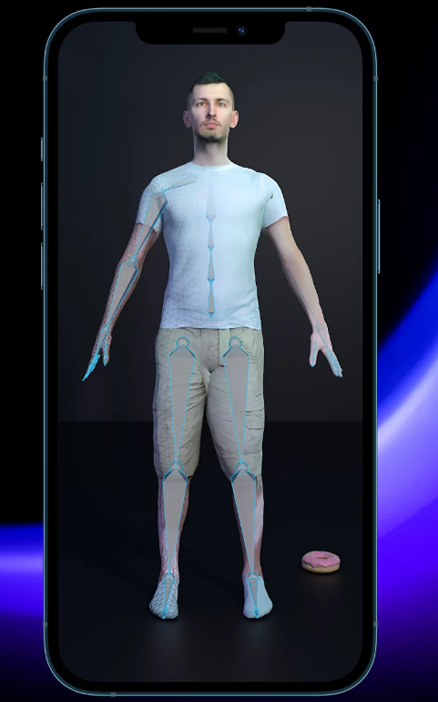
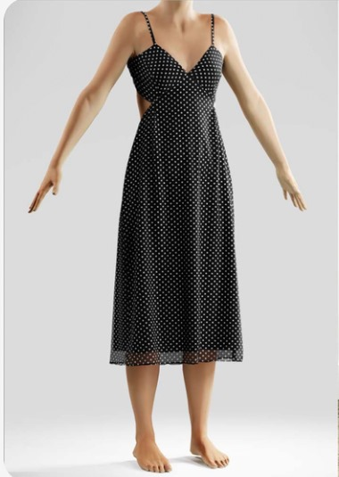
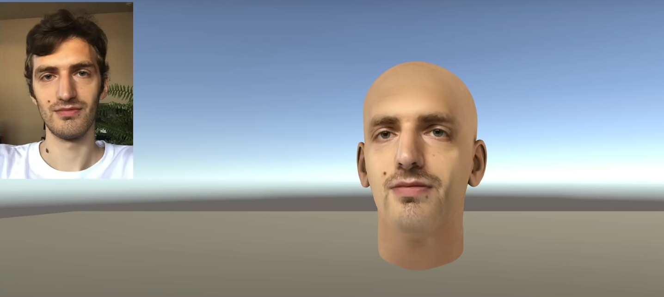

DESIGN MOCKUPS

Slide 6


DEVELOPMENT
TOOLS
.
Software : Unity 3D Game Engine, Node.js, Three.js (for 3D rendering)
Languages : C, JavaScript, HTML, CSS
Frameworks : React JS, Bootstrap
SDKs : WebXR Device API
Other Tools : Postman (for API testing), Git (for version control)
Hardware:Desktop, Mobile

Slide 7

ANYTHING YOU WANT TO ADD
This is a placeholder slide [OPTIONAL] . Use this space to add any additional information that you think is important for your project. Some ideas include:
Unique Selling Points: Highlight what makes your project stand out from the competition.
Future Plans: Discuss your plans for further development or scaling your project.
Acknowledgements: Recognize any individuals or contributed to your project.
Feel free to customize this slide to ﬁt your speciﬁc needs.
organizations that have

